Slide 1
UT 1.1: Network basics

Slide 2
TRUNC
Introduction.
Architectures based on levels.
IP addressing.

Slide 3
1. Introduction
Networks are today an essential part of information systems.
They allow a user to:
•communicate with others (chat, mail, videoconference,...)
•sharing resources, both information (shared folders) and devices (printers, hard drives,...) with the economic savings that this entails.

Slide 4
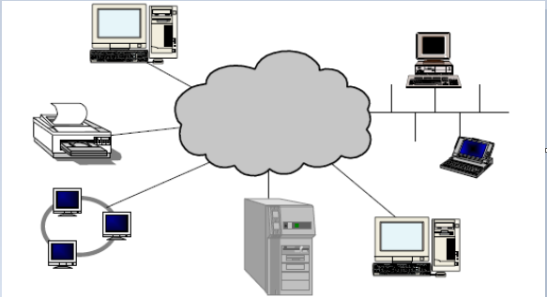
1. Introduction
The following figure shows an Internet network or "cloud" formed by the interconnection of a number of physical communications networks or "small clouds".
NETWORK

Slide 5
1. Introduction
All machines are assumed to "speak" the same communication language based on a set of protocols known as TCP/IP.

Slide 6
2. Architectures based on levels

Slide 7
2. Architectures based on levels
To improve the functioning of the networks, it was thought to divide their functions into levels.
The base model is known as OSI, and has 7 levels.
OSI is an academic model that served as the basis for other architectures. As it is too strict, it has hardly been implemented in practice.

Slide 8
2. Architectures based on levels
The most widespread architecture is TCP/IP, which has two important advantages.
COMPLEXITY REDUCTION: Facilitates design work through a structure more understandable by a division at different levels of communication. This feature allows different programmers to develop their work on different levels without interfering.
FACILITATES TECHNOLOGICAL CHANGE: Allows any changes made at any level do not affect the rest of the levels of architecture.

Slide 9
2. Architectures based on levels
In the figures we see how the two architectures are divided into layers.
Niveles TCP/IP
Niveles OSI

Slide 10
2. Architectures based on levels
Communication between the different levels of the same system consists in sending the data or information to be transmitted from UP-DOWN (level "n" to level 1) in the sending system, and from DOWN - UP (level 1 to level "n") in the receiving system.

Slide 11
2. Architectures based on levels
If we are communicating different systems, different systems must agree to use a communication protocol that both know.

Slide 12
3. IP addressing
3.1 Class method
3.2 Classless Interdomain Routing(CIDR)

Slide 13
3. IP addressing
The TCP/IP name comes from the Transmission Control Protocol (TCP) and the Internet Protocol (IP).
The IP protocol (Internet Protocol) is, as its name suggests, the network protocol used on the Internet.

Slide 14
3. IP addressing
IP is a protocol that does not incorporate many functionalities and whose main tasks are the following:
•Routing data packets.
•Assign addresses to data packets.
•Identify the content type and service type.
•Fragment packages too large.

Slide 15
3. IP addressing
As IP is a datagram-based protocol, it has the following characteristics:
It is not connection-oriented. The protocol is independent of whether routers or destination are available or not.
In each packet goes the destination address, choosing the route to follow (the so-called next jump) on each router depending on the destination and network conditions.
There is no control of the data flow or the order in which packets arrive.

Slide 16
3. IP addressing
These features produce a number of advantages, which make IP a very interesting protocol for heterogeneous networks, such as the Internet.
•This is a simple protocol, since there is no establishment or end of connection.
•If one of the intermediate nodes fails, packets can be routed on the other hand.

Slide 17
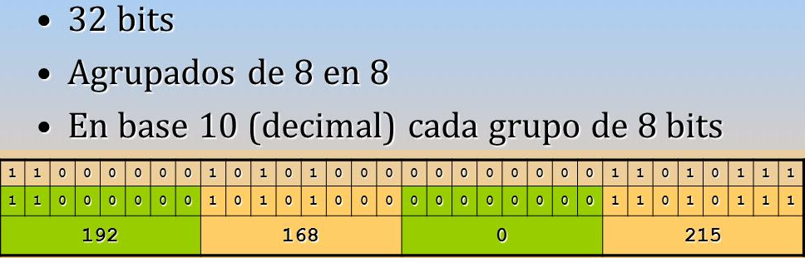
3. IP addressing
IP addresses are addresses that identify a node or entity in networks (for example, a computer, printer, or web server).
In IPv4, these addresses are represented by a 32-bit word. They are usually represented as a sequence of four decimal numbers between 0 and 255 (8 bits 2⁸=256 possible values) separated by points. In the example in the figure, 192.168.0.215.

Slide 18
3. IP addressing
In IPv6, these addresses are represented by a 128-bit word, grouped into 8 groups of 16 bits each, separated by two points (:).
Each 16-bit group is represented with its corresponding hexadecimal number.
An example of IPv6 address could be
20AB : 0D9B : 80AF : 08DE : A3A0 : : 037F : 703A

Slide 19
3. IP addressing
An IP address has two parts:
•Network part: part of the address used by the router.
•Host part: specific part of the node that is on a given network.
All hosts on the same network share the same network part on their IP address, it is the host part that sets them apart from the other hosts on the network.
The network mask (which we will see later) is the one that determines how many bits belong to the network part and how many to the host part

Slide 20
3. IP addressing
Activity 1: Switch the following IP addresses to binary:
192.168.14.125
172.16.61.24
Activity 2: Change the following binary IP addresses to decimal:
00001010000000000000000000001101
11000000101010000001110100001111

Slide 21
3. IP addressing
3.1 Method of the classes
Initially, addressing was carried out using so-called class addressing, with five types of networks, depending on the number of bits dedicated to the network and host parts. These types of networks and their characteristics are summarized in the table in the figure.
Class | most significant bits | Bit number for the network address | number of networks | Bit number for the host | Number of network hosts | Values of the first octet
A | 0 | 8 | 126 | 24 | 16.777.214 | 0-127
B | 10 | 16 | 16.384 | 16 | 65.534 | 128-191
C | 110 | 24 | 2.097.152 | 8 | 254 | 192-223
D | 1110 | not applicable | not applicable | not applicable | not applicable | 224-239
E | 1111 | not applicable | not applicable | not applicable | not applicable | 240-255

Slide 22
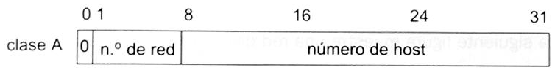
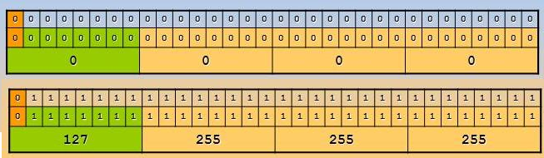
3. IP addressing
IPv4 address classes are specified in RFC 790 and 791.
Class A addresses use 8 bits to identify the network and 24 for the computer. The first bit of the address is always a 0 (figure). This means that the first decimal number cannot exceed 127.
The range of possible class A addresses would be that of the figure.

Slide 23
3. IP addressing
Class A addresses are assigned to large networks, as they could have more than 16 million hosts.
Addresses 0.x.x.x and 127.x.x.x are not used as they are reserved for test functions.
The address 127.0.0.1 identifies the local host (the address of the host itself) and is used for local loop testing (or loopback). Routers or local machines can use this address to send packets to themselves.

Slide 24
3. IP addressing
To give addresses to hosts we have 24 bits.
Hosts with all values to 0 or 1 are not possible (the first because it would match the network address and the second because it would match the broadcast address), so we will have to subtract 2 to the number of possible addresses.
Broadcast or multicast is a form of information transmission where a sending node sends information to a multitude of receiving nodes simultaneously, without the need to reproduce the same node-by-node transmission
We can use 224-2=16.777.214 addresses to hosts .

Slide 25
3. IP addressing
Activity 4: Why can there be up to 126 class A networks?
Activity 5: what is the lowest class A address that can be given to a host? and the highest?
Activity 6: Ping address 127.15.18.25, what happened? why?

Slide 26

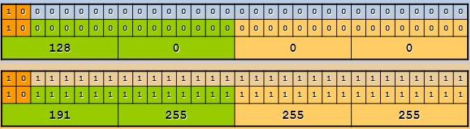
3. IP addressing
Class B IP addresses use 16 bits to identify the network and 16 bits to identify the computer. The first bits of the address are 1 and 0 (figure). This forces the first decimal number to be between 128 and 191.
The range of possible class B addresses would be that of the figure.

Slide 27
3. IP addressing
Class B addresses are assigned to mid-sized networks, up to 65,534 computers.
We use 16 bits for the network part (green zone in the figure above), but the first two bits are fixed (10). Then the possible networks of class B are: 2¹⁴ =16.384.
16 bits are used for the computer part on each network (orange zone in the figure above). Then the possible computers in each class B network are: 2¹⁶-2 = 65534, computers with all bits at 0 or 1are not allowed

Slide 28
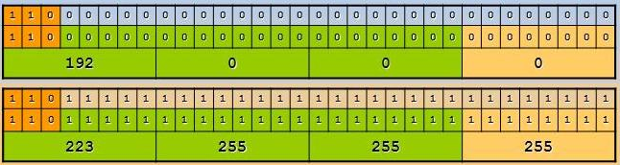
3. IP addressing
Class C IP addresses use 24 bits to identify the network and 8 bits to identify the computer. The first bits of the address are 1, 1 and 0. This forces the first decimal number to be between 192 and 223.
The range of possible class C addresses would be that of the figure.

Slide 29
3. IP addressing
Class C addresses are assigned to small networks, up to 254 hosts (2⁸-2).
We have 24 bits for the network part (green zone in the figure above), but the first three bits are fixed (110). Then the possible class C networks are: 221 = 2097152.
8 bits are used for the computer part on each network (orange zone in the figure above). Then the possible computers in each class C network are: 2⁸-2 = 256 - 2. We subtract 2 because computers with all bits to zero or to one are not possible.

Slide 30
3. IP addressing
Class D addresses are reserved for multicast. It is used in group or multicast communications with the aim of sending the same information to all members of the group (possibly geographically dispersed over multiple Internet networks).
The first 4 bits of a multicast address are 1110. The remaining 28 bits specify a particular multicast group without containing a network address as in class A, B and C addresses.
The full range of multicast addresses is: 224.0.0.0-239.255.255.255. Address 224.0.0.0 is reserved, that is, it cannot be assigned to any group.

Slide 31
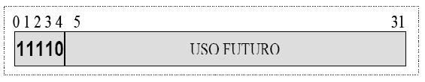
3. IP addressing
Class E addresses are reserved for research.
The first 5 bits are 11110, so the first byte takes values between 240 and 255.

Slide 32
3. IP addressing
Activity 7: what are the first two class B addresses? and the last two?
Activity 8: what is the lowest class B address that can be given to a host? and the highest?
Activity 9: what are the first two class C addresses? and the last two?
Activity 10: what is the lowest class C address that can be given to a host? and the highest?

Slide 33
3. IP addressing
network masks
In class addressing, (A, B, and C), from the IP of a computer, we can get:
what class it belongs to, and from the class it is known how many IP bits belong to network identification and how many to computer identification.

Slide 34

3. IP addressing
An IP network mask is called a 32-bit number that is created as follows:
the bits that identify the network are all set to one.
the bits that identify the computer are all set to zero.
In this way, the network masks would be:
-class A: 255.0.0.0

Slide 35

3. IP addressing
-B Class: 255.255.0.0
-C Class: 255.255.255.0
To know which network a host belongs to, we make a logical AND between its IP and its mask.

Slide 36
3. IP addressing
Activity 11: complete the table
IP | Class | Mask
38.152.25.18
222.11.208.15
54.126.14.244
172.226.18.35
208.29.59.111
7.8.9.10
197.225.89.222
101.22.55.14

Slide 37
3. IP addressing - private addresses
There are 3 ranges of IP addresses that are private and cannot be assigned to any computer on the Internet.
They are described in document RFC 1918. They are:
class | Starting IP | Final IP | Block | Networks | hosts
A | 10.0.0.0 | 10.255.255.255 | 10/8 | 1 | 2²⁴ – 2
B | 172.16.0.0 | 172.31.255.255 | 172.16/12 | 16 | 2¹⁶ – 2
C | 192.168.0.0 | 192.168.255.255 | 192.168/16 | 256 | 2⁸ - 2

Slide 38
3. IP addressing -private addresses
private addresses
Any organization can assign the computers of the IPs local area network included in the above schema. The decision to choose one or the other network will depend on the number of teams the organization has, and future development forecasts.
Within the organization’s network, teams will have a private IP address. Outwardly, that address is not visible. Viewed from the outside all computers share the same public IP.

Slide 39
3. IP addressing - private addresses
These addresses do not have a global meaning, an organization cannot connect to the Internet without using some kind of conversion. This translation is called NAT (Network Address Translation).
The RFC that defines NAT is 1631.
NAT is the method for converting an address in a network to a different address in another network. It is used when a packet travels from one network to another and the host address on the source network is not valid on the target network.

Slide 40
3. IP addressing
Activity 12: what are the first two private class B addresses? and the last two?
Activity 13: what is the lowest class B private address that can be given to a host? and the highest?
Activity 14: what are the first two private class C addresses? and the last two?
Activity 15: what is the lowest class C private address that can be given to a host? and the highest?

Slide 41
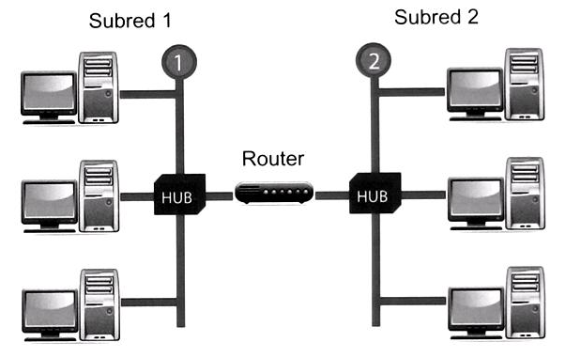
3. IP addressing
SubNetworks
By using physical interconnection devices we can divide a type A, B or C network into smaller segments to increase its efficiency.
Network segments separated by routers are called subnets.

Slide 42
3. IP addressing
The reasons for creating subnets are:
Class A, B and C networks do not fit all the needs that companies have in terms of local networks.
Classes A and B are very large. Each contains many hosts. And class C is very small, 254 hosts.
Sometimes it is convenient a network with a number of hosts more suited to the needs of companies.

Slide 43
3. IP addressing
3.2 CIDR (Clasless InterDomain Routing)
CIDR emerged in response to the limitations of the class method:
the number of addresses available in the class B address space was about to run out,
Internet routing tables were almost full and all IP addresses would be assigned in the future.

Slide 44
3. IP addressing
The main features of CIDR are:
It uses binary notation, that is, it divides each address into 32 bits.
It does not define a default subnet mask based on the IP address, each host is configured with a custom subnet mask.
Subnet masks are always composed of contiguous maximum values (1s) followed by contiguous minimum values (0s).
Subnet addresses with all subnet bits at 0 or 1 are allowed. The number of subnets on which a network can be divided is calculated as 2n, where n is the number of 1s in the mask. The number of hosts allowed for a subnet is calculated from the number of 0s in the mask as 2n-2, where n is the number of 0s. The two addresses that are subtracted are the network and the broadcast addresses.

Slide 45
3. IP addressing
In CIDR notation, the IP address of a network is represented with a prefix that is an IP address, followed by a "/" and a number that indicates the number of bits to 1 in the mask counting from the left.
For example, 192.38.0.0, which would have been an illegal class C address, is now a valid address written as 192.38.0.0/16. It would indicate a mask with the first 16 bits at 1 (255.255.0.0).

Slide 46
3. IP addressing
In CIDR notation, the IP address represented by the /20 mask could be an IP address of class A, B or C.
Routers supporting CIDR do not use the first three bits of the address to determine whether the packet’s host is local or remote, as in the class method. Instead, they rely on the information that the bitmask provides with the path to make a determination.

Slide 47
3. IP addressing
CIDR optimizes IP address allocation by using supernet and subnet processes.
The opposite operation is known as supernetworking, is a procedure that combines multiple addresses to form a single network ID. The subnet process divides a large network into multiple subnets.

Slide 48
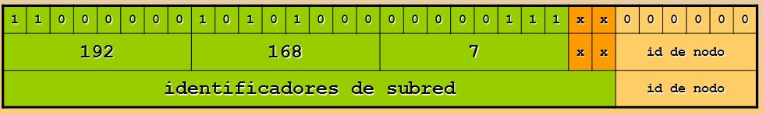
3. IP addressing
Let’s look at an example with the class C address 192.168.7.0. Here, 24 bits identify the network, and 8 the computer. Let’s take 2 bits of the node identifier, or computer, to create subnets (figure). How many subnets can you have taking two bits of the same byte to make subnets? In principle, 22 = 4 (00, 01, 10, 11) And how many nodes/computers in each subnet? In principle, 26 = 64 minus 2.

Slide 49
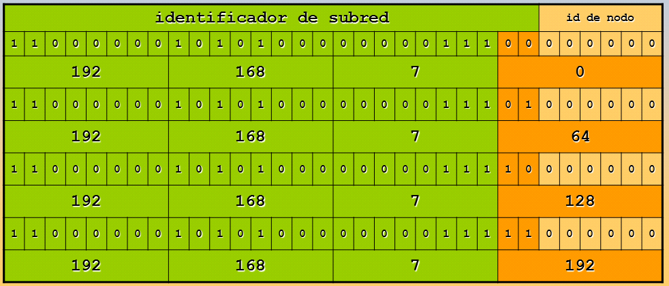
3. IP addressing
In the figure we see which subnets we have created: 192.168.7.0, 192.168.7.64, 192.168.7.128 and 192.168.7.192.

Slide 50
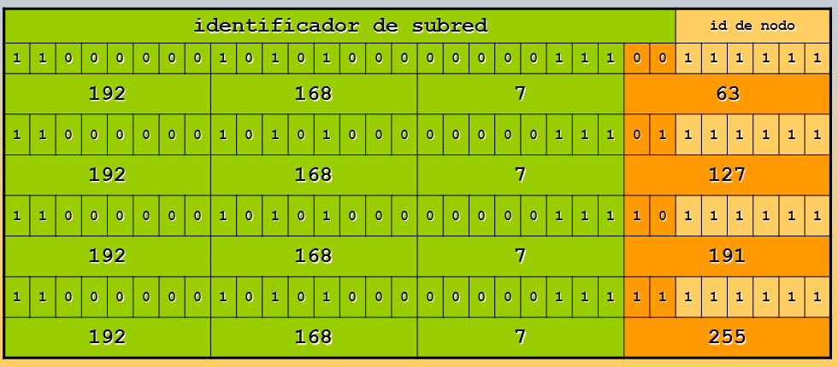
3. IP addressing
The broadcast addresses of each subnet are obtained as in the case of classed networks: The broadcast address of a subnet is the ip of the subnet that maintains all network bits, and changes all node bits to one.
For the four subnets in the above example:

Slide 51
3. IP addressing
From the above it is noted that: since in class C networks can address 254 computers (2⁸ - 2 = 256 - 2 = 254). If the class C network is subdivided into four subnets, 62 computers can be addressed in each subnet (2⁶ - 2 = 64 - 2 = 62). The 4 subnets can then address 4 * 62 = 248 computers, while the class C network can address 254 computers.
That is, 6 ips have been lost when creating subnets.

Slide 52
3. IP addressing
Activity 16: complete the table.
Activity 17: repit the last activity but using a 27 bits mask
Activity 18: given the network 194.168.100.0, what mask must be applied to divide it into 16 subnets? How many nodes can each of these 16 subnets contain?
Subred | Primera IP de nodo de la subred | Última IP de nodo de la subred | Broadcast | Máscara
192.168.7.0/26
192.168.7.64/26
192.168.7.128/26
192.168.7.192/26

Slide 53
3. IP addressing
CIDR does not define a default subnet mask based on the IP address. Instead, each host is configured with a custom subnet mask, and each router is sent the IP address with its mask. The router then uses both to determine the network identifier of the computer to which the packet must be forwarded.
To calculate the network identifier when the IP address is specified in CIDR notation the following steps are followed:
1º) The IP address is converted to binary format.
2º) The mask is used to determine the number of bits in the IP address that form the network identifier.
3º) 0s are added to the network identifier to get its four-byte structure.

Slide 54
3. IP addressing
For example, consider IP address 10.217.123.7/20. The subnet mask consists of 20 contiguous 1s, the network identifier is formed by the first 20 bits on the IP address followed by 0s.
Rule: We look at the IP address and subnet mask bits in columns. When both are 1, we write in the corresponding column of the network identifier a 1. In other case, we write a 0.

Slide 55
3. IP addressing
If we apply the above rule to the example address, we will see that the network to which the IP address belongs is 10.217.112.0.
Dirección IP | Binary | 00001010 | 11011001 | 01111011 | 00000111
 | Decimal | 10 | 217 | 123 | 7
Máscara de subred | Binary | 11111111 | 11111111 | 11110000 | 00000000
 | Decimal | 255 | 255 | 240 | 0
ID de red | Binary | 00001010 | 11011001 | 01110000 | 00000000
 | Decimal | 10 | 217 | 112 | 0

Slide 56
3. IP addressing
Activity 19: Given a computer whose IP is given in CIDR notation of the form 192.168.19.25/28, find out what its network identifier is.
Activity 20: Given the IP addresses 10.217.123.7/20 and 10.218.102.31/20 belonging to two computers, find out if they are on the same network or not.
Activity 21: Given IP addresses 192.168.15.5/28 and 192.168.15.116/28 belonging to two computers, find out if they are on the same network or not.

Slide 57
3. IP addressing
super-network
A network is said to be a supernetwork when the number of bits used by the associated mask is lower than what it would be using the class method.
The supernet process is a strategy that combines multiple addresses in the class environment in a single direction in the classless environment. What we do is remove bits to the default mask starting from the right.

Slide 58
3. IP addressing
Suppose we have assigned the following class C addresses:
200.200.192.0
200.200.193.0
200.200.194.0
200.200.195.0
With the default mask (255.255.255.0), they would be separate networks. However, using a 255.255.192.0 mask subnet, each of those subnets would appear as part of the 200.200.192.0 network because all of the masked bits are the same.

Slide 59
3. IP addressing
Activity22: Given the address 220.195.227.12 with the subnet mask 255.255.240.0, is it a supernet?
Activity 23: Which of the following addresses are supernets?
a) 198.32.0.0/16
b) 190.32.0.0/16
c) 200.200.192.0/18
d) 204.1.64.0/20

Slide 60
3. IP addressing
3.3 Gateway
The gateway is the node that gives hosts a network access to an external network.
The gateway is the default route assigned to a computer. Through that node, any packet is sent to any network that is not in the computer’s routing table. It’s usually a router.

Slide 61
3. IP addressing
For example, a computer on the 200.200.200.192/27 network has the following routing table.
Through which router (in the following figure) should a package intended for a computer with the address 200.200.200.251?
network | Mask | Gateway
200.200.200.248 | 255.255.255.248 | 200.200.200.194
200.200.200.64 | 255.255.255.192 | 200.200.200.194
0.0.0.0 | 0.0.0.0 | 200.200.200.193

Slide 62
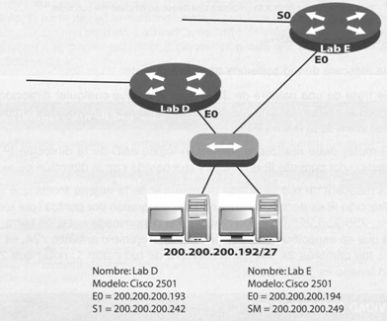
3. IP addressing
What the routing table means is that any packet that is addressed to either of the first two networks will exit through the Ethernet interface (here called EO) of the router named LabE. Otherwise, the default gateway (represented by 0.0.0.0) is the Ethernet interface of the LabD router), so any packet that is addressed to any other network will exit through that router.

Slide 63
3. IP addressing
To see which network is targeted the package whose destination is 200.200.200.251, you must perform the AND operation with the different network masks, starting with the smallest network.
We switch the network address and mask to binary and perform the AND operation.
200.200.200.251 = 11001000. 11001000. 11001000. 11111011
255.255.255.248 = 11111111. 11111111. 11111111. 11111000
To perform the AND operation, when the corresponding bit of the network mask and the one of the IP address are 1, it is 1. In any other case it will be 0:
11001000.11001000.11001000.11111000 = 200.200.200.248
It coincides with the first network: the packet belongs to the network 200.200.200.248/29, so it must be directed to the Ethernet interface of the LabE router, with address 200.200.200.194.

Slide 64
3. IP addressing
Activity 24: With the same routing table of the resolved activity, find out through which router the packet leaves with the address 200.200.200.245.
Repeat the exercise for a package to address 200.200.200.91.

Slide 65
4. IPv6 Protocol
This new version of the protocol is designed to be included by default in most devices that access the Internet and offers many new features to manage networks more efficiently:
Greater space for addressing.
Security is defined as part of the protocol, incorporating IPSec natively.
Eliminates the need for NAT.
Remove the checksums. It has its own error control mechanism that avoids having to perform traditional checksums and results in faster connection.
New design that will allow the protocol to easily adapt to future functionalities.
Automatic addressing of the interface.

Slide 66
4.1 IPv6 addresses
An IPv6 address is a set of eight fields formed by hexadecimal strings (128 bits) separated by the colon character (:), which offer a addressing space of 2128 possible values. Each string consists of four hexadecimal characters (0-9, a-f). Each group of fields has a special meaning:
The first three fields (48 bits) contain the site prefix describing the public topology (usually assigned by the ISP or a RIR).
The fourth field (16 bits) is the subnet identifier (it can be change to create subnets). Unlike IPv4, it is not necessary to use bits of the interface Id. (host part) to make subnets.
The last four fields (64 bits) contain the interface identifier. It is automatically configured from the MAC address of the interface or manually in EUI-64 format.

Slide 67
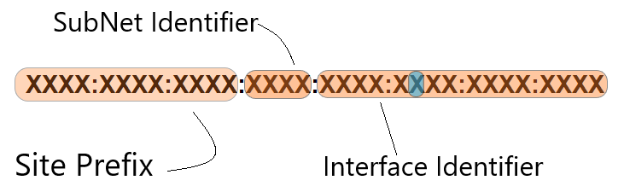
4.1 IPv6 addresses

Slide 68
4.1 IPv6 addresses
IPv6 addresses are very extensive and complex. There are a number of rules that establish how they should be formed and that allow summarizing them to facilitate their treatment:
It’s insensitive to upper and lower case.
It is possible to use a hybrid IPv6-IPv4 format so that the end of the address can be an IPv4 address in decimal notation.
The zeros at the beginning of each field can be omitted.
The field, or set of consecutive fields, with all zeros can be omitted, but only once, being represented by two characters two points (:).

Slide 69
4.1 IPv6 addresses
Examples of how to abbreviate IPv6 addresses:
2001:0db8:0234:C1AB:0000:00A0:0000:003F
We remove the zeros at the beginning of each group:
2001:db8:234:C1AB:0000:A0:0000:3F
We eliminate groups that are all zeros:
2001:db8:234:C1AB::A0:0:3F o
2001:db8:234:C1AB:0:A0::3F

Slide 70
4.1 IPv6 addresses
another example:
0000:0000:0000:0000:0000:0000:ffff:192.168.10.5
We remove the zeros at the beginning of each group:
0:0:0:0:0:0:ffff:192.168.10.5
We eliminate groups that are all zeros:
::ffff:192.168.10.5 -> Abreviada

Slide 71
4.1.2 Types IPv6 addresses
Link-Local
Unicast
Global Address
IPv6 assigned to IPv4
Embedded IPv4
IPv6 compatible IPv4
multicast (defined group difusión)
Anycast (indiferent destination difusion)

Slide 72
4.1.2 IPv6 addresses Types
Unicast address: Especifies a unique interface
Link-Local-Use: are used for addressing on a single link for purposes such as auto-address configuration. Its prefix is fe80::/10.
Global Unicast Addresses (GUA): are used for global communication. They are similar in function to IPv4 addresses under CIDR (classless interdomain routing). They are routable and accessible on IPv6 Internet. Its prefix starts with 001 in binary (then the first digit will be 2 or 3 in hexadecimal) and is the prefix or network portion of the address assigned by the ISP.

Slide 73
4.1.2 IPv6 addresses Types
multicast: Specifies a set of interfaces, possibly in multiple locations. This address can never be the source address of a package. Its prefix is ffXY::/8.
Indifferent broadcast address (anycast): Specifies a set of interfaces, possibly in different locations, sharing the same address. A packet sent to this address is transmitted only to the nearest member (according to the router routing table). It uses the same prefix as global unicast addresses (GUA).

Slide 74
4.1.2 Types IPv6 addresses
Activity
Search the Internet for information about the process of obtaining an EUI-64 identifier and determine its value for MAC 08:00:27:74:B5:5D and 08-00-27-2C-11-8A.

Slide 75
4.1.3 subnet prefix
IPv6 abandons the use of mask, now appearing the concept "subnet prefix length".
An IPv6 address prefix (the network portion of the address) is represented with the format:
IPv6 Address/prefix
This format is similar to IPv4 address masks in CIDR notation

Slide 76
4.1.3 subnet prefix
Activity
Reduce as much as you can the following IPv6 addresses:
a) 2001:0db8:3c4d:0015:0000:0005:2129:303f
b) 2001:0000:0000:3c4d:0025:0000:5324:0020
c) 2001:0db8:3c4d:0015:0000:0300:0009:0030

Slide 77
5 Network services, protocols and ports
It is called "network service" the set of resources and processes that seek to meet the needs that customers demand through the network.
Whether they are accessed by nodes of the same network or if the clients are nodes outside it, the implementation of these services reports a high number of advantages (allow more efficient use of resources, improve process productivity, facilitate configuration tasks...).

Slide 78
5 Network services, protocols and ports
Generally, network services are implemented in client-server architectures, which favors their consumption by customers. The nodes that host and offer these services are called servers. However, in some cases the service is distributed among several nodes that cooperate with each other (P2P architectures), thus decentralizing the role of the server, which happens to reside in this case in each and every peer.

Slide 79
5 Network services, protocols and ports
Network services may reside on computers with operating systems specially designed to behave as servers (SOLARIS, AIX. HP-UX, Ubuntu Server, Fedora, Microsoft Windows Server...), but may also be hosted on computers with client operating systems (Ubuntu Desktop, MacOS, Microsoft Windows 10...).
Some of these operating systems already have the service installed by default, which may be disabled, or offer the possibility to install it easily from their own sources. In other cases, it is necessary to install the necessary software from external sources to the computer which, occasionally, is from third parties. However, for a computer to act as a server it is necessary to have the software and hardware necessary to provide the specific service, because not all services require the same requirements.

Slide 80
5 Network services, protocols and ports
Every network service needs a series of protocols that govern how the service will be offered:

Slide 81
Network services, protocols and ports
The internet layer is responsible for identifying a host within the network and the transport layer is responsible for identifying the process or service of the recipient node that will receive the data, which allows multiple services to be running simultaneously on the server computer.
This is supported by the port, which is a number which makes it possible to identify the recipient service of the package received. Also, the service has to make use of one of the protocols of this level (TCP, UDP, SCTP) to get transfer the information as a complete and error-free message.

Slide 82
5 Network services, protocols and ports
Although each protocol’s RFC defines the ports where the service should listen to requests by default, requests can usually be modified.
To do this, you must take care not to choose any port that is being used by another service, otherwise one of the two will not start.
Last but not least, make sure customers know the new listening port, otherwise they will not be able to access the service.

